Slide 1


PROJECT 3: Data Cleaning
`
Date: Monday Jan. 3rd 2022
GROUP 5 PRESENTATION
Salaries Data
Presented by:
Olga SHAVRINA
Yanis BENNEOUALA
Nadim SAAD

Slide 2


Project Process
PROJECT PLANNING
01
As a first step we planned our work on Trello
Manage our Git Repository
DATA WRANGLING, CLEANING, MANIPULATION CODING WITH PANDAS
02
Import & examine provided salaries dataset for potential issues
Data cleaning/ manipulation techniques in Python explaining our used approaches (why and how) (Convert data, look for missing data, check data inconsistencies & outliers, remove duplicates, impute nulls, and encode)
03
EXPORT CSV FILE
Exporting the clean data into a CSV file using Pandas
04
ANALYSE THE DATASET IN MYSQL USING ALCHEMY LIBRARY
Prepare at least 3 tables analyzing the dataset in MySQL (using group by statement)

Slide 3




Challenges
Data examination applying the manipulation methods and testing our hypotheses
Project breakdown into different steps (checklist of covered topics in the process)
Tools handling: Trello, Github, Python (using Pandas), SQL (using Alchemy Library, …)
SQL queries difficulties and extracting the results
Summarize our findings
Teamwork and distribution of the tasks at hand
3

Slide 4

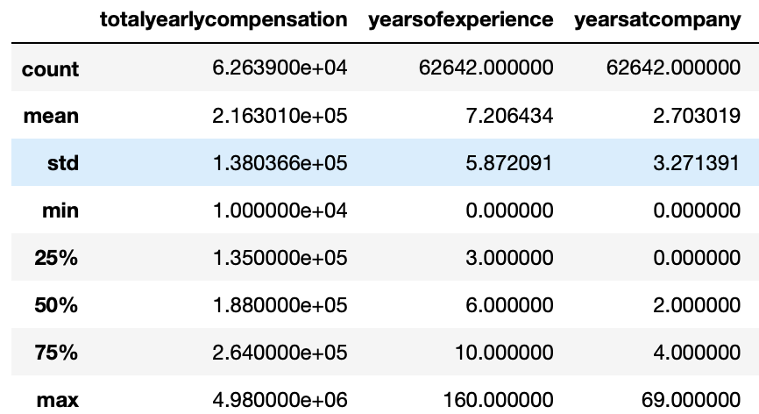
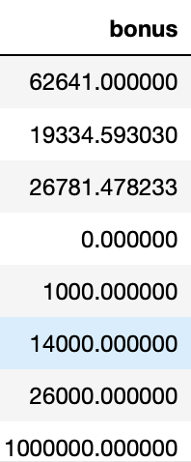




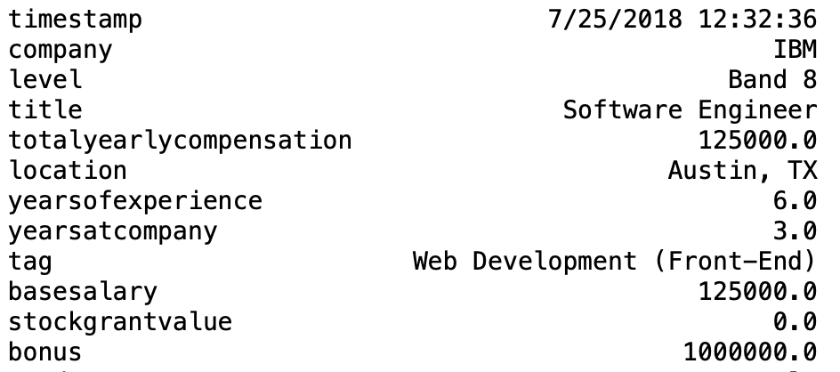
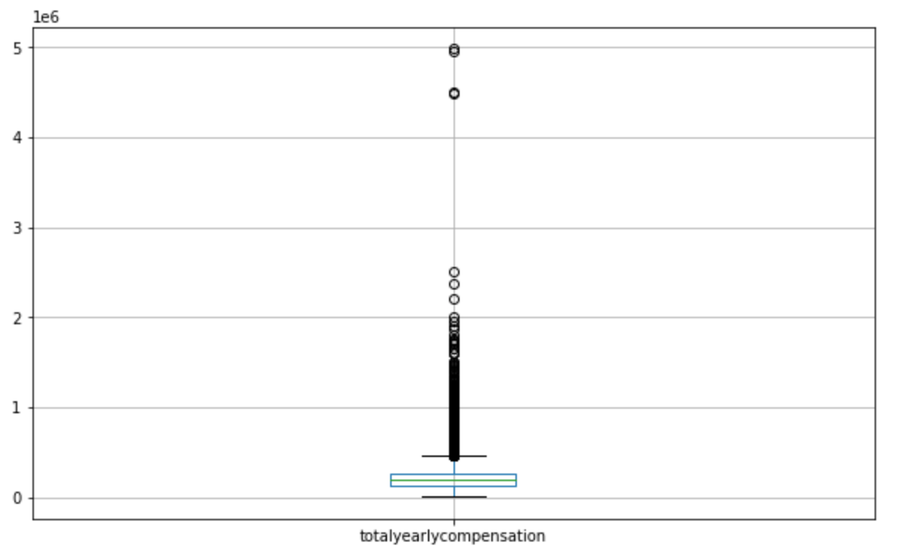

Our learnings and the improvements we made
df.shape
We noticed data incosistencies (years of experience, base salary, bonus, etc.)
Dealt with data anomalies when:
Yearly salary > yearly compensation
Base salary 1.05 times > total yearly compensation
# of years in a company > total experience
Dropped columns not relevant to the study (tag, gender, race, etc.)
Replaced zero and NaN values i.e. salaries by total year compensation
Added new columns i.e. avg_salary (by title, by company, etc.)
Grouped data by rows i.e. employees by company
We used LabelEncoder for several columns (city, title, buz type, etc.)
Consolidated our findings by using isna() for summing up values and cor ()
Finally, we copied the data file to a new excel file
df.describe()
df.loc[638]
EXAMPLE
Yearly Compensation
np.mean(df["bonus"])
Matplotlib (for outliners)
4

Slide 5
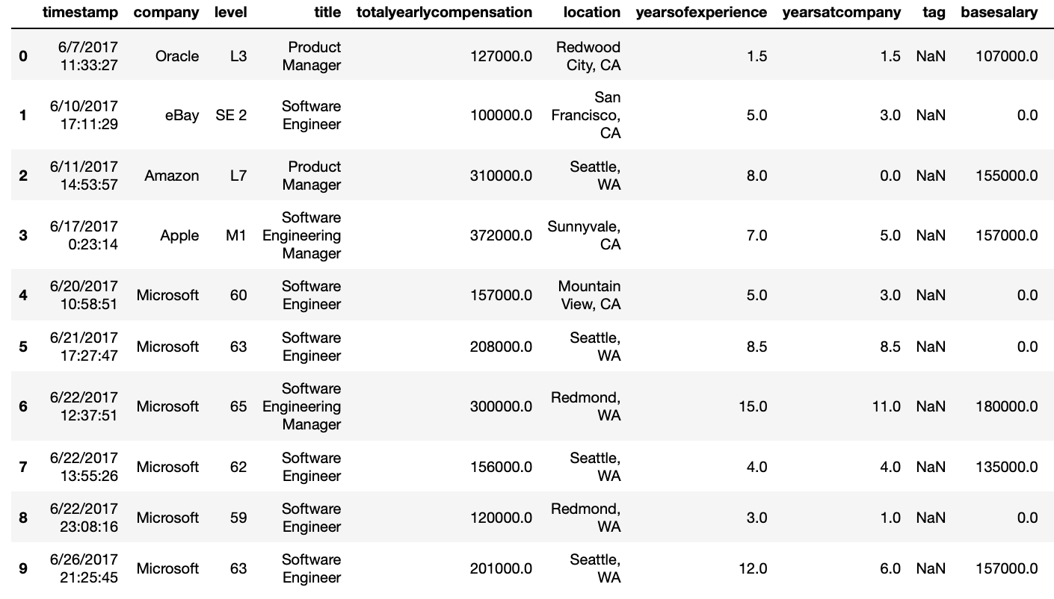
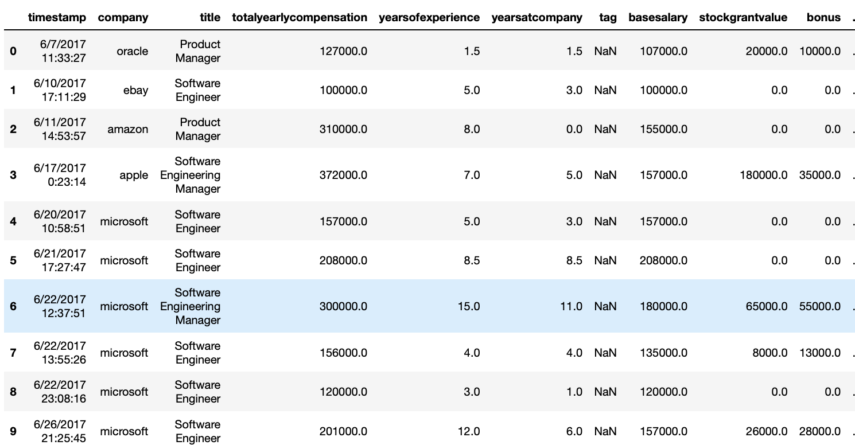
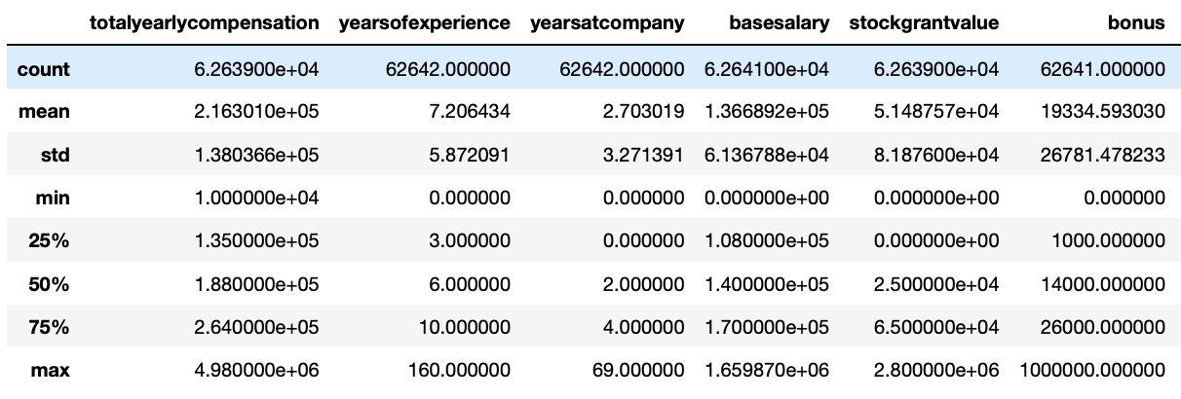
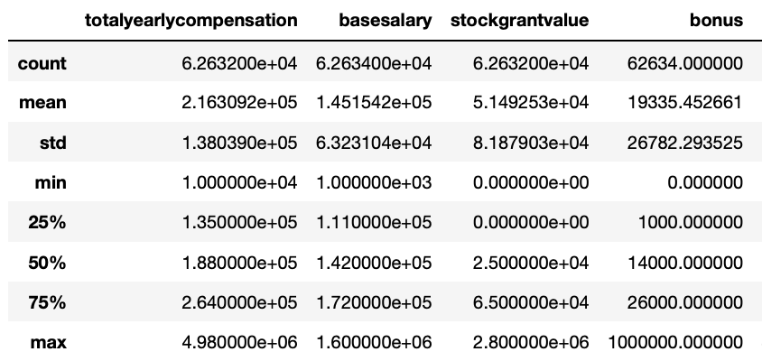
Highlights: comparing the initial and final datasets
Initial Datasets
Final Datasets
Import new Excel file to SQL

Slide 6
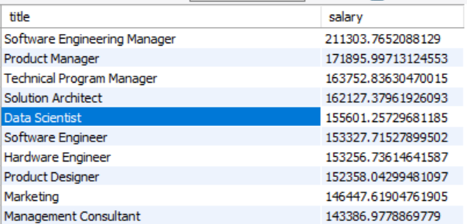
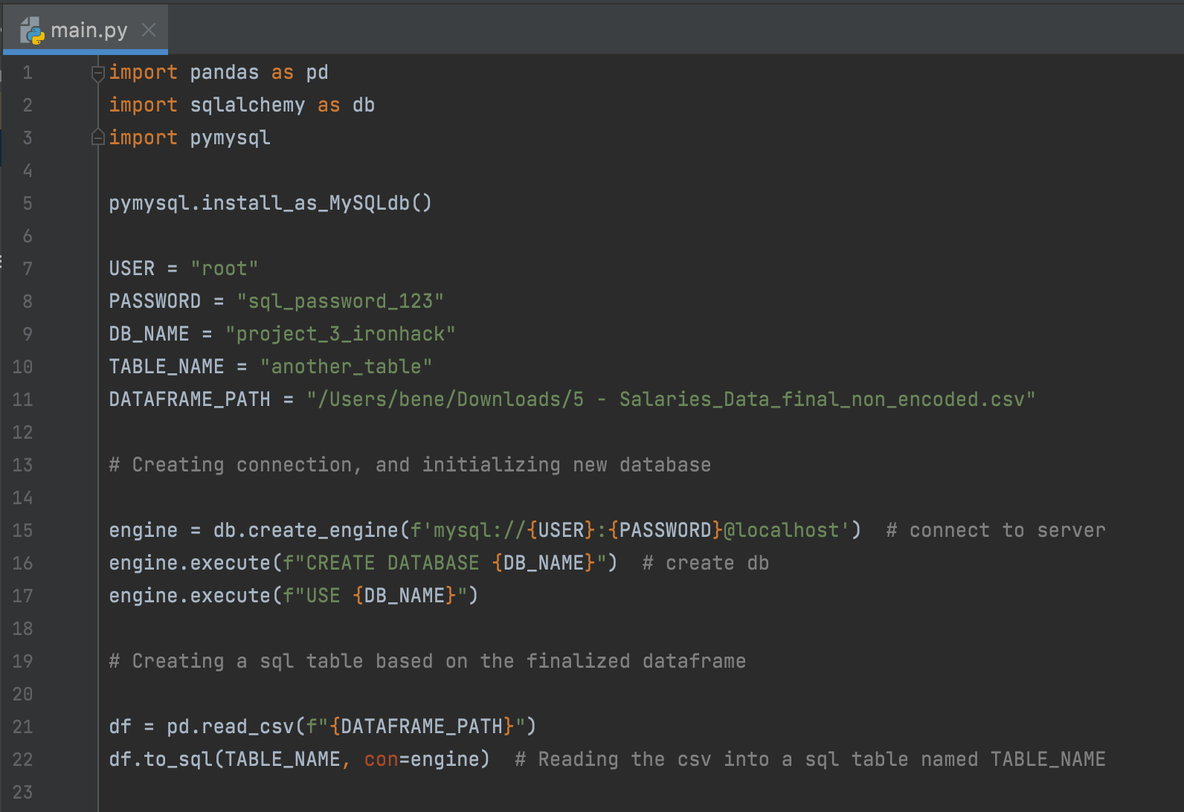
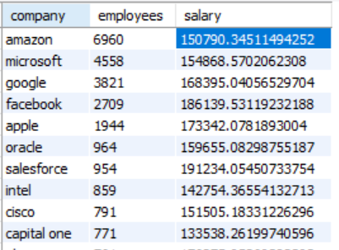
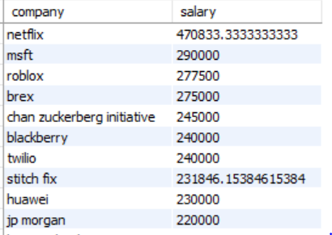
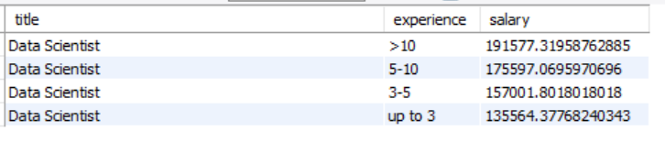
Importing our dataframe to SQL using Alchemy
SQL Queries
Basic Salary/ Title
We can edit our main highlights here.
Basic Salary & Number of Employees/ Company
Basic Salary / Company
Basic Salary & Years of Experience/ Title

Slide 7

THANK YOU!
`
Any Questions?

